Slide 1
How to Join Online Classes From Student App

Slide 2
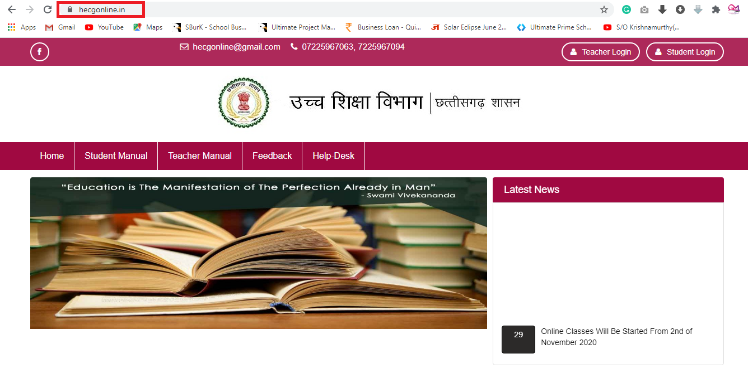
Open Website – https://hecgonline.in/

Slide 3
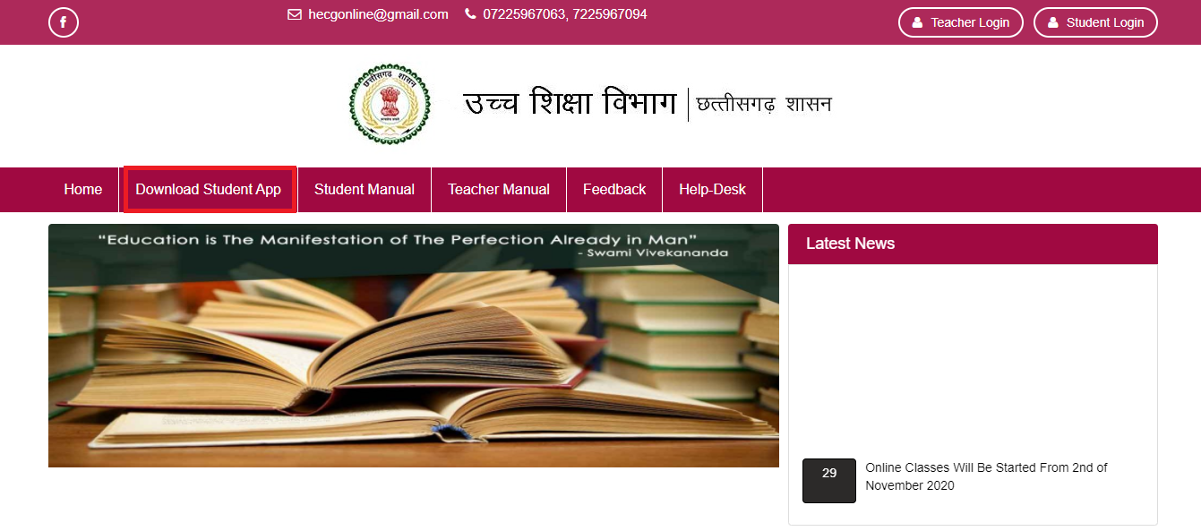
Click On Download Mobile App

Slide 4
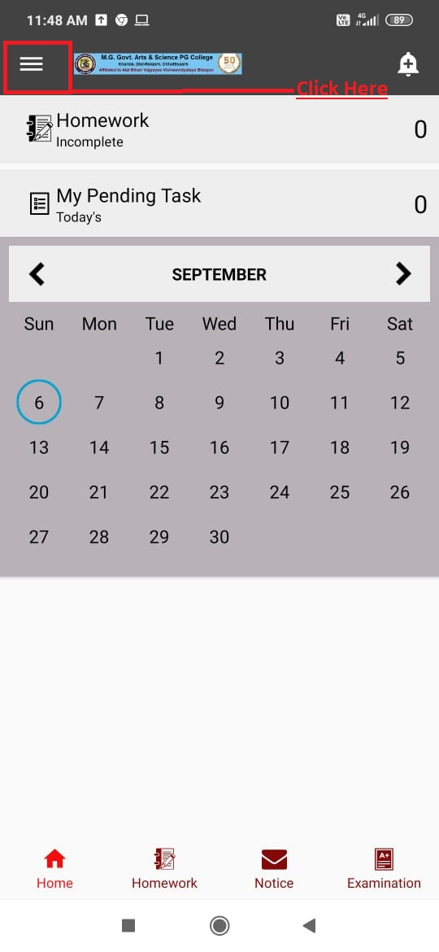
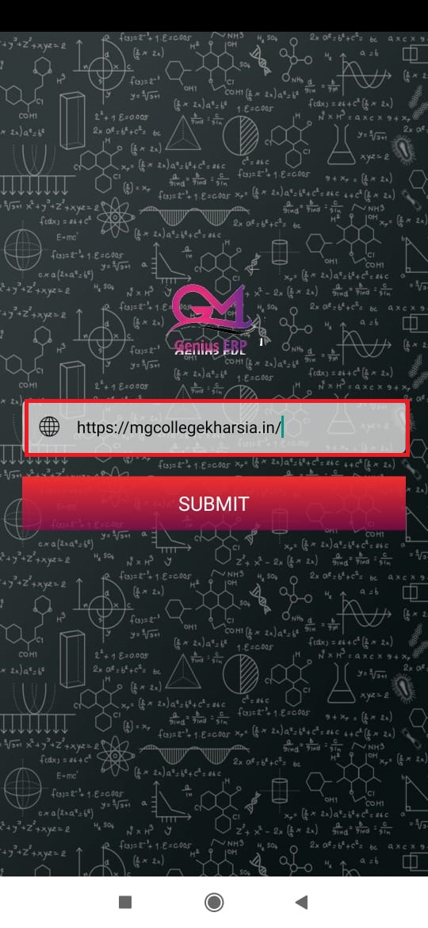
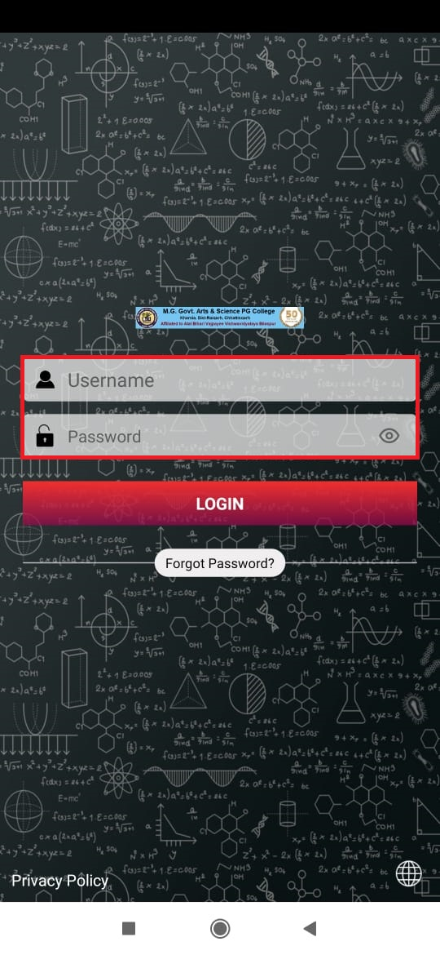
First Type Website – https://hecgonline.in/
Type Username and Password
Student DashBoard Will Come

Slide 5
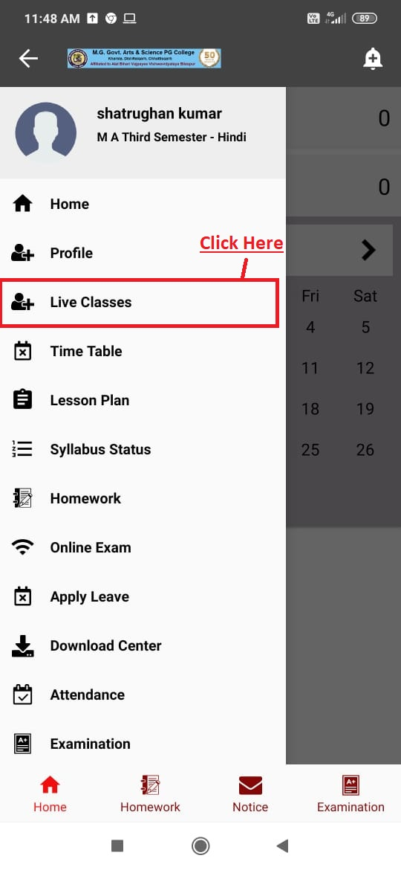
Click on Top Left Corner
Click on Live Classes
Your Scheduled Classes Will Come
Clilck on Join Class
You Will Join Class through Live Class

